Slide 1
Collaborative IT security service in Generative Adversarial Network

Slide 2

3rd International Conference on Computational Intelligent Systems 2024
(ICCIS2024)
Conference Date: December 2-3, 2024 (Monday & Tuesday)

Slide 3


Author(s) Affiliation(s)
Zaheen Fatima Department of computer Engineering, Hamdard University, Karachi,Pakistan. Zaheen.fatima@hamdard.edu.pk
Dr.Rashid Hussain Department of Electrical Engineering, Hamdard University, Karachi,Pakistan. Rashid.hussain@hamdard.edu.pk
Muhammad Shakir Department of Robotics and Artifical Intelligence, Szabist University, Karachi,Pakistan. Muhammad.Shakir@szabist.edu.pk

Slide 4
Contribution of Research
Application of Random Forest and K Nearest Neighbor algorithm in the IoTID20 dataset.
In IoT environment provides security with the classification of attacks.
Use GAN for the detection of attacked and normal packets with synthetic data generation that helps to improve accuracy and work with novel cyber-attacks.
Use of GAN in research helps to reduce the false positive result rates i.e. to reduce probability of showing false normal packets as attacked by generating more realistic training dataset.

Slide 5
Literature Review

Slide 6
Literature Review
Ref# | Dataset | Method | Performance Evaluation
[11] | CSE-CIC-IDS2018 | Data Merging Data Cleaning Data Transformation and split Numerical Standardization Training and Model Evaluation Testing Classification Model Evaluation | Accuracy Precision Recall F-Scores
[13] | NSL-KDD UNSW-NB15 IoT data set | Preprocessing Support Vector Machine and Decision Tree Generative model training Auto encoder training Predictive model training | Accuracy Precision Recall F-Score
[14] | BoT-IoT | Feature selection Data Splitting into training and testing Machine Learning model Random Forest Support Vector Machine Artificial Neural Network GAN data applied to trained IDS. | Accuracy Precision Recall F-Score

Slide 7
Literature Review
Ref# | Dataset | Method | Performance Evaluation
[15] | Industrial Control System Instructional Cybersecurity Lab (ICSICL) dataset Internet of Things Dataset | Feature Extraction Long Short-Term Memory, Multilayer Perceptron Generator Selector Discriminator | Accuracy Precision Recall F-Score
[16] | NSL-KDD dataset | Feature Extraction Data Processing Data Analysis Data Splitting to training and testing Classification with Long short-term memory (LSTM), recurrent neural network (RNN), and gated recurrent unit (GRU) | Accuracy Score
[17] | NSL-KDD Dataset | Data preprocessing Generator Discriminator Training | Detection rate Excess Information Rate

Slide 8
Methodology of Proposed Work

Slide 9
Dataset
The dataset used for this research is IoTID20.
This dataset is generated in an environment with a Security Camera, Speaker, Smart Phone, Access point, and Laptop [20].
This dataset has 83 Network features and 3 Label Features.
The preprocessing of the dataset is done. In the preprocessing step, the dataset is normalized using the column normalization technique and supervised machine learning algorithms.
The data is initially categorized as Normal or attacked data.
The category and sub-category for Normal data is also considered Normal.
The categories of anomalous data are DoS, Mirai, MITM, and Scan.
The sub-categories of anomalous data are Syn Flooding, Brute Force, HTTP Flooding, UDP FloodingARP SpooﬁngHost Port, and OS.

Slide 10
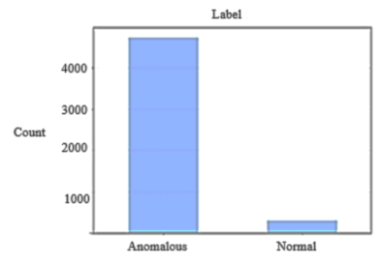
Dataset
Figure 1: Class Distribution of Label Column

Slide 11
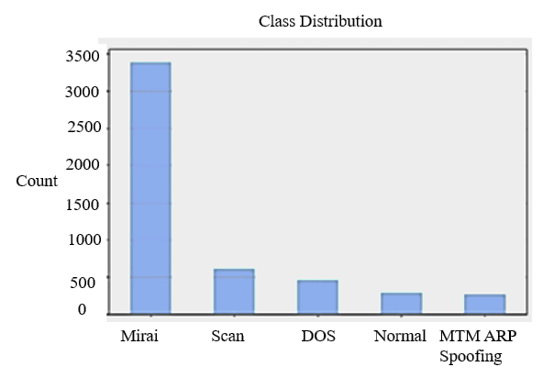
Dataset
Figure 2: Class Distribution of Category Column

Slide 12
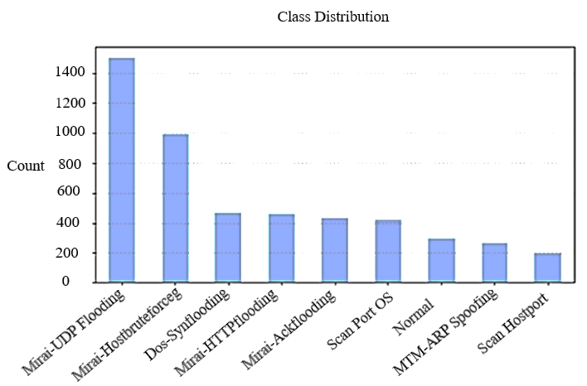
Dataset
Figure 3: Class Distribution of Sub Category Column

Slide 13
Framework of Proposed Method
The dataset is preprocessed so that it adopts the form completely that is acceptable for the machine learning algorithm.
A feature engineering process was performed to remove correlation features.
The data is converted to the form acceptable for Machine Learning Algorithm.
The dataset is split into Train and Test parts.
The Train and Test part of the dataset is processed through the Generative Adversarial Network and Machine learning algorithms Random Forest and K-nearest neighbor.
The trained split part of the dataset comes to the GAN and goes to the Generator and Discriminator.
The generator converts the real data to fake data by adding noise and the discriminator distinguishes between the real and fake data.
GAN AI helps to add more variations in training data and makes it diverse for high-class research.
The GAN-generated data is trained on the Machine Learning algorithms. The result from the test data that comes on IDS is compared and the data is classified as normal or anomalous.

Slide 14
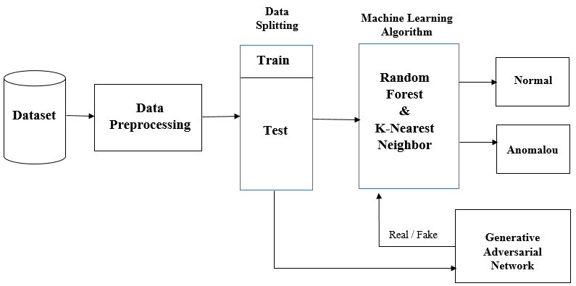
Framework of Proposed Method
Figure 4: Framework of Proposed Method

Slide 15
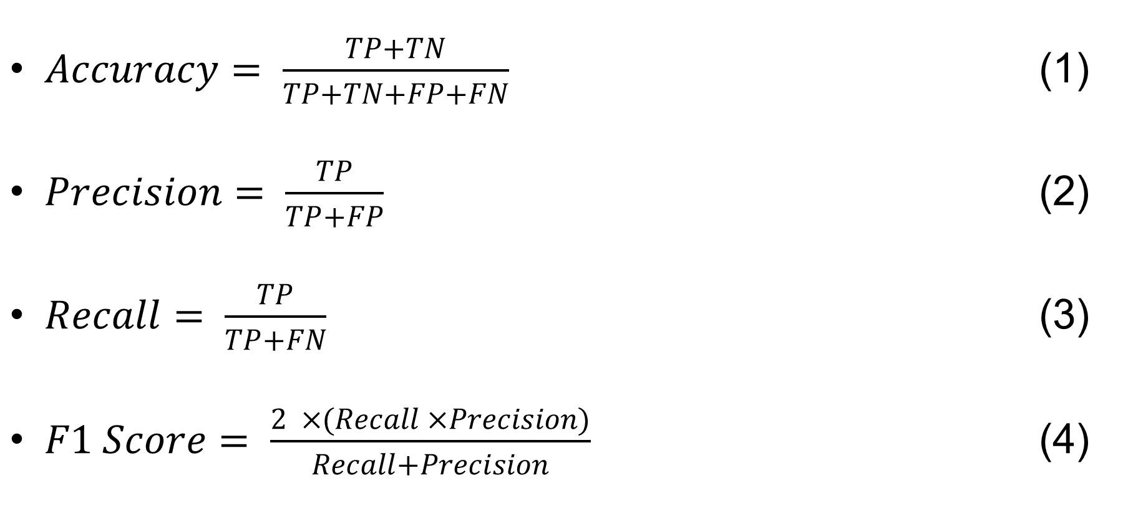
Evaluation Metrics
$Accuracy= \frac{TP+TN}{TP+TN+FP+FN}$ (1)
$Precision= \frac{TP}{TP+FP}$ (2)
$Recall= \frac{TP}{TP+FN}$ (3)
$F1 Score= \frac{2 ×(Recall ×Precision)}{Recall+Precision}$ (4)

Slide 16
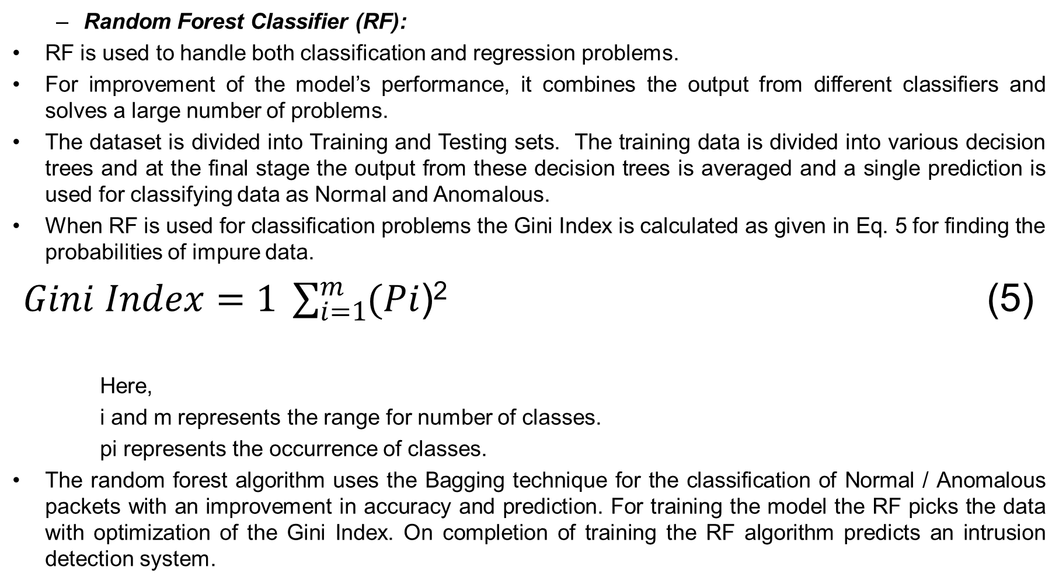
Classification
Random Forest Classifier (RF):
RF is used to handle both classification and regression problems.
For improvement of the model’s performance, it combines the output from different classifiers and solves a large number of problems.
The dataset is divided into Training and Testing sets. The training data is divided into various decision trees and at the final stage the output from these decision trees is averaged and a single prediction is used for classifying data as Normal and Anomalous.
When RF is used for classification problems the Gini Index is calculated as given in Eq. 5 for finding the probabilities of impure data.
$Gini Index=1 \sum_{i=1}^{m}{(Pi}$)² (5)
Here,
i and m represents the range for number of classes.
pi represents the occurrence of classes.
The random forest algorithm uses the Bagging technique for the classification of Normal / Anomalous packets with an improvement in accuracy and prediction. For training the model the RF picks the data with optimization of the Gini Index. On completion of training the RF algorithm predicts an intrusion detection system.

Slide 17
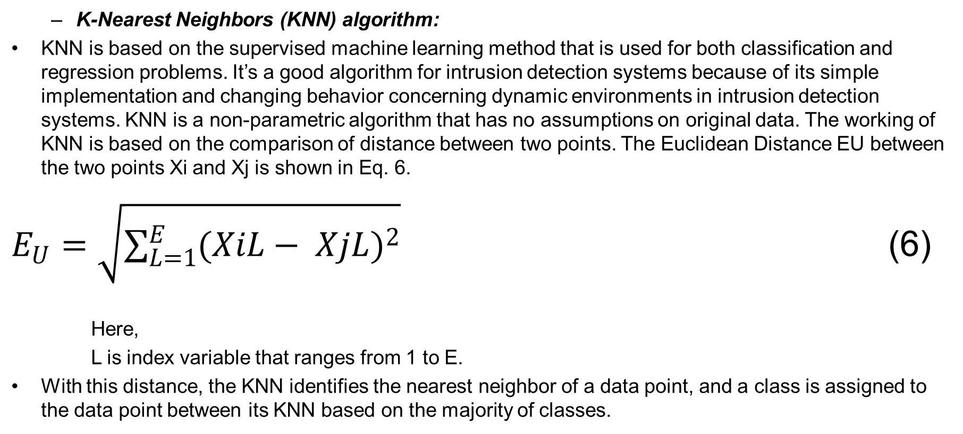
Classification
K-Nearest Neighbors (KNN) algorithm:
KNN is based on the supervised machine learning method that is used for both classification and regression problems. It’s a good algorithm for intrusion detection systems because of its simple implementation and changing behavior concerning dynamic environments in intrusion detection systems. KNN is a non-parametric algorithm that has no assumptions on original data. The working of KNN is based on the comparison of distance between two points. The Euclidean Distance EU between the two points Xi and Xj is shown in Eq. 6.
$E_{U}=\sqrt{\sum_{L=1}^{E}{({XiL− XjL)}^{2}}}$ (6)
Here,
L is index variable that ranges from 1 to E.
With this distance, the KNN identifies the nearest neighbor of a data point, and a class is assigned to the data point between its KNN based on the majority of classes.

Slide 18
Preliminary results
Algorithm/ Performance | Accuracy | Precision | Recall | F1 Score
RF | 96.20% | 0.94 | 1.00 | 0.97
KNN | 97.51% | 0.98 | 1.00 | 0.99
The proposed model is trained with a Random Forest algorithm and achieved an accuracy of 96.20%
And also trained with K Nearest Neighbor has an accuracy of 97.51%. on the IoTID20 dataset.

Slide 19
Conclusion
This paper uses the Generative Adversarial Network with the Machine Learning Algorithm Random Forest and K Nearest Neighbor for the classification of network packets as Normal or Anomalous.
Numerous papers have been published for intrusion detection systems but these papers do have not a good aptitude for corresponding patterns, a large number of false positive predictions, and the detection of anomalies mainly dependent on human intelligence.
This research provides valuable information about the GAN AI with its benefits for using with ML learning algorithms.
This research uses the IoTID20 dataset for experimental purposes. The benefit of using this dataset is the generation of this dataset in a real-world environment. The dataset provides network packets with different attacks and sub-categories of attacks.
The results may be enhanced and diversified predictions of various kinds of attacks in the real environment.
The proposed model is trained with a Random Forest algorithm and achieved an accuracy of 96.20% and with K Nearest Neighbor has an accuracy of 97.51%. on the IoTID20 dataset.
This research enhanced in the future with other ensemble learning algorithms XGBoost, Support vector machine, Neural network, and Deep Neural Network.
A lightweight, cheap, and comprehensive IDS will need to be implemented in the future with other available and real-world datasets. The work will also enhance with multiclass classification of attacks.

Slide 20
References used in the Paper
[1] Ö. Aslan, S. S. Aktuğ, M. O. -Okay, A. A. Yilmaz and E. Akin, "A Comprehensive Review of Cyber Security Vulnerabilities, Threats, Attacks, and Solutions," Electronics, vol. 12, no. 6, p. 1333, 2023.
[2] R. Chaganti, B. Bhushan and V. Ravi, "A survey on Blockchain solutions in DDoS attacks mitigation : techniques, open challenges and future directions," Computer Communications, vol. 197, pp. 96-112, 2023.
[3] E. C. P. Neto, S. Dadkhah, R. Ferreira, A. Zohourian, R. Lu and A. A. Ghorbani, "CICIoT2023: A Real-Time Dataset and Benchmark for Large-Scale Attacks in IoT Environment," Sensors, vol. 23, no. 13, p. 5941, 2023.
[4] Y. Xia, Y. Xu, S. Mondal and A. K. Gupta, "A Transfer Learning-Based Method for Cyber-Attack Tolerance in Distributed Control of Microgrids," IEEE Transactions on Smart Grid, vol. 15, no. 2, pp. 1258 - 1270, 2023.
[5] A. Mtair and A.-H. , "Predictions of Cybersecurity Experts on Future Cyber-Attacks and Related Cybersecurity Measures," International Journal of Advanced Computer Science and Applications, vol. 14, no. 2, pp. 801-809, 2023.
[6] X. Huang, D. Zou, G. Cheng, X. Chen and H. Xie, "Trends, Research Issues and Applications of Artificial Intelligence in Language Education," Educational Technology & Society, vol. 26, no. 1, pp. 112-131, 2023.
[7] H. Pallathadka, E. H. Ramirez-Asis, T. P. Loli-Poma, K. Kaliyaperumal , R. J. M. Ventayen and M. Naved, "Applications of artificial intelligence in business management, ecommerce and finance," Materials Today, vol. 80, pp. 2610-2613, 2023.
[8] M. A. Umar, Z. Chen, K. Shuaib and Y. Liu, "Effects of Feature Selection and Normalization on Network," Elsevier, 2024.
[9] F. Chen, Z. Ye, C. Wang, L. Yan and R. Wang, "A Feature Selection Approach for Network Intrusion Detection Based on Tree-Seed Algorithm and K-Nearest Neighbor," in IEEE 4th International Symposium on Wireless Systems within the International Conferences on Intelligent Data Acquisition and Advanced Computing Systems (IDAACS-SWS), Lviv, Ukraine,, 2018.

Slide 21
References used in the Paper
[10] D. Javaheri, S. Gorgin, J.-A. Lee and M. Masdari, "Fuzzy Logic-Based DDoS Attacks and Network Traffic Anomaly Detection Methods: Classification, Overview, and Future Perspectives," Information Sciences, vol. 626, pp. 315-338, 2023.
[11] Y.-C. Wang, Y.-C. Houng, H.-X. Chen and S.-M. Tseng, "Network Anomaly Intrusion Detection Based on Deep Learning Approach," Sensors, vol. 23, no. 4, p. 2171, 2023.
[12] K. Zhang, O. Kwon and H. Xiong, "The Impact of Generative Artificial Intelligence," arXiv preprint, 2023.
[13] C. Park, J. Lee, Y. Kim, J.-G. Park, H. Kim and D. Hong, "An Enhanced AI-Based Network Intrusion Detection System Using Generative Adversarial Networks," IEEE Internet of Things Journal, vol. 10, no. 3, pp. 2330-2345, 2022.
[14] M. Ali, "Generative Adversarial Network for intrusion detection system," 2021.
[15] J. L. Purser, "USING GENERATIVE ADVERSARIAL NETWORKS FOR INTRUSION DETECTION IN CYBER-PHYSICAL SYSTEMS," 2020.
[16] F. Rustam, A. Raza, I. Ashraf and A. D. Jurcut, "Deep Ensemble-based Efficient Framework for Network Attack Detection," in 21st Mediterranean Communication and Computer Networking Conference (MedComNet), 2023.
[17] Z. Lin, Y. Shi and Z. Xue, "IDSGAN: Generative Adversarial Networks for Attack Generation against Intrusion Detection," Cham: Springer International Publishing, pp. 79-91, 2022.
[18] V. R. Saddi, S. K. Gopal, A. S. Mohammed, S. Dhanasekaran and M. S. Naruka, "Examine the Role of Generative AI in Enhancing Threat Intelligence and Cyber Security Measures," in 2nd International Conference on Disruptive Technologies (ICDT) , 2024.
[19] F. Alwahedi, A. Aldhaheri, M. A. Ferrag, A. Battah and N. Tihanyi, "Machine learning techniques for IoT security: Current research and future vision with generative AI and large language models," Internet of Things and Cyber-Physical Systems, vol. 4, pp. 167-185, 2024.

Slide 22
References used in the Paper
[20] I. Ullah and Q. H. Mahmoud, "A Scheme for Generating a Dataset for Anomalous Activity Detection in IoT Networks," in Canadian conference on artificial intelligence, 2020.
[21] I. Ortega-Fernandez and F. Liberati, "A review of denial of service attack and mitigation in the smart grid using reinforcement learning.," Energies, vol. 16, no. 2, p. 635, 2023.
[22] A. Affinito, S. Zinno, G. Stanco, A. Botta and G. Ventre, "The evolution of Mirai botnet scans over a six-year period," Journal of Information Security and Applications, vol. 79, p. 103629, 2023.
[23] S. A. M. Al-Juboori, F. Hazzaa, Z. S. Jabbar, S. S. and H. M. Gheni, "Man-in-the-middle and denial of service attacks detection using machine learning algorithms," Bulletin of Electrical Engineering and Informatics, vol. 12, no. 1, pp. 418-426, 2023.
[24] K. Pramilarani and . P. V. i Kumari, "Cost based Random Forest Classifier for Intrusion Detection System in Internet of Things," Applied Soft Computing, vol. 151, p. 111125, 2024.
[25] A. M. Sudarsan, M. S. RajKumar, M. R. Chowdhary, T. Sathwik, D. Swathi and D. Raja, "GuardianAI: Smart Intrusion Detection for Modern Threats," Research Square, 2024.

